Slide 1


Application of Data Analysis Techniques in Exploring Mental Health Trends
This project applies various data analysis, preprocessing, and visualization techniques to a dataset on mental health disorders. The goal is to analyze trends, identify correlations, forecast future prevalence rates, and perform clustering analysis to group countries based on mental health metrics. The dataset, sourced from Kaggle, contains information on the prevalence of various mental health disorders across different countries and years.

Slide 2
Dataset Description
The dataset includes information on the prevalence of mental health disorders across different countries and years. It contains columns for Entity (country name), Code (country code), Year, and prevalence rates for various disorders including Schizophrenia, Depressive disorders, Anxiety disorders, Bipolar disorders, and Eating disorders. All prevalence rates are age-standardized for both sexes.
Entity
Code
Disorders
Country name
Country code
Schizophrenia, Depression, Anxiety, Bipolar, Eating
Total No of Countries
Years
Total Rows
214
1990 - 2019
6420

Slide 3

Project Objectives
1
Trend Analysis
2
Correlations
Identify patterns in mental health disorder prevalence.
Explore relationships between different disorders.
3
Prevalence Forecasting
4
Clustering Analysis
Predict future trends in disorder prevalence.
Group countries based on mental health metrics.

Slide 4
Activity Flow
Data Collection
EDA
Clustering
Gathering data from Kaggle.
Understanding data characteristics.
Clustering based on disorders.
1
2
3
4
5
Data Preprocessing
Time Series Analysis
Cleaning and preparing data.
Analyzing trends over time.

Slide 5
Data Preprocessing
Prior to analysis, the data underwent preprocessing to ensure consistency and reliability. This involved cleaning the data to remove inconsistencies, missing values, and outliers that could affect the analysis. Transformations were applied to achieve stationarity where necessary for time series analysis.
1
Data Cleaning
Remove inconsistencies and missing values
2
Outlier Detection
Identify and handle outliers in the dataset
3
Transformation
Apply transformations for stationarity

Slide 6


Exploratory Data Analysis
Exploratory data analysis was conducted to gain insights into the underlying patterns and trends in mental health disorder prevalence over time. Line plots, histograms, and other graphical methods were used to visualize the data and identify systematic variations. The analysis revealed skewed distributions for most disorders, with long tails towards higher values. Box plots identified outliers, especially for depressive and anxiety disorders.
Distribution of Disorders
Outlier Detection
Histograms showing skewed prevalence of mental health disorders
Box plots revealing outliers in depressive and anxiety disorders

Slide 7
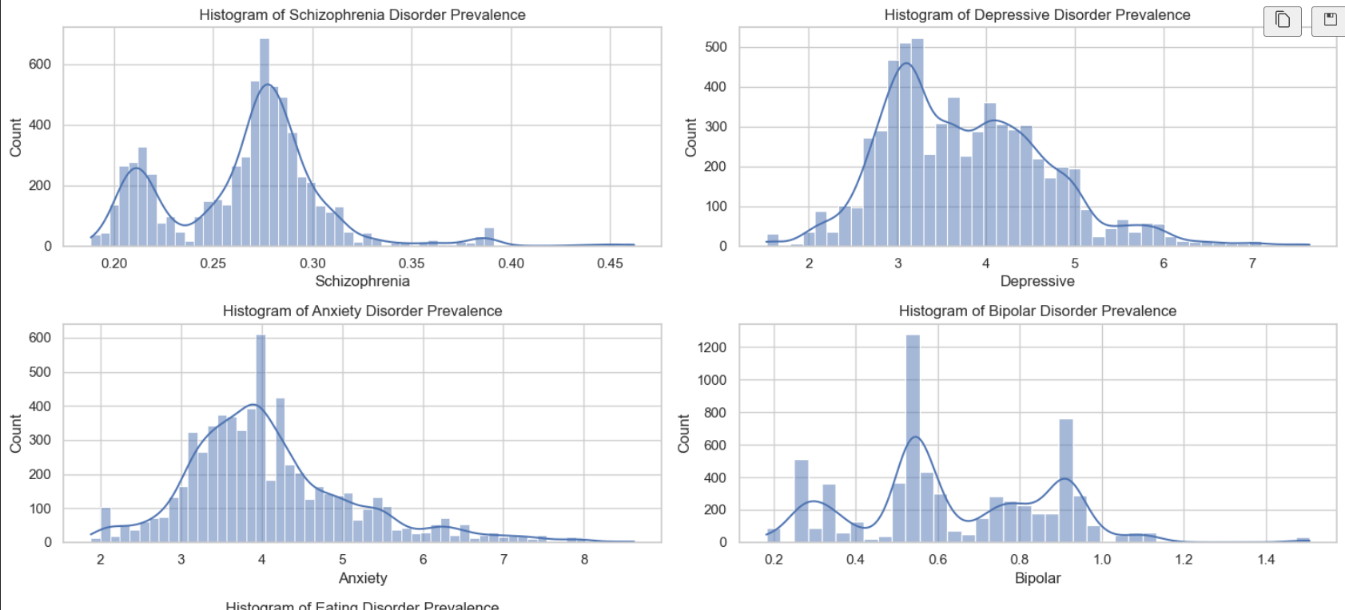
Histograms of mental Disorders
Prior to analysis, the data underwent preprocessing to ensure consistency and reliability. This involved cleaning the data to remove inconsistencies, missing values, and outliers that could affect the analysis. Transformations were applied to achieve stationarity where necessary for time series analysis.
1
Data Cleaning
Remove inconsistencies and missing values
2
Outlier Detection
Identify and handle outliers in the dataset
3
Transformation
Apply transformations for stationarity

Slide 8
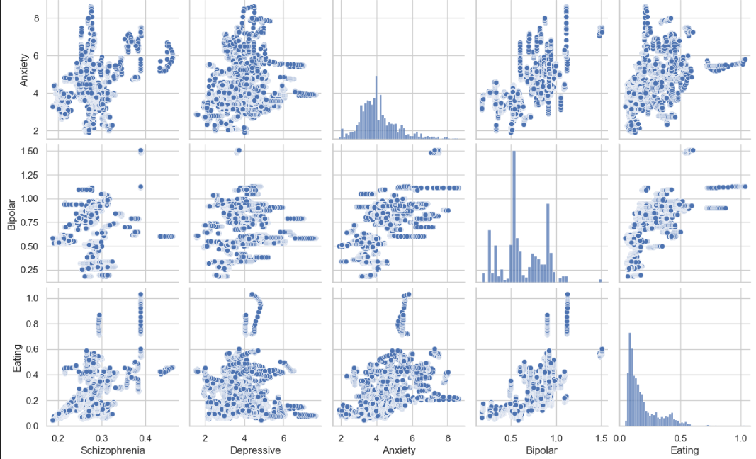
Pair Plot to see relationship between Disorders
Prior to analysis, the data underwent preprocessing to ensure consistency and reliability. This involved cleaning the data to remove inconsistencies, missing values, and outliers that could affect the analysis. Transformations were applied to achieve stationarity where necessary for time series analysis.
1
Data Cleaning
Remove inconsistencies and missing values
2
Outlier Detection
Identify and handle outliers in the dataset
3
Transformation
Apply transformations for stationarity

Slide 9
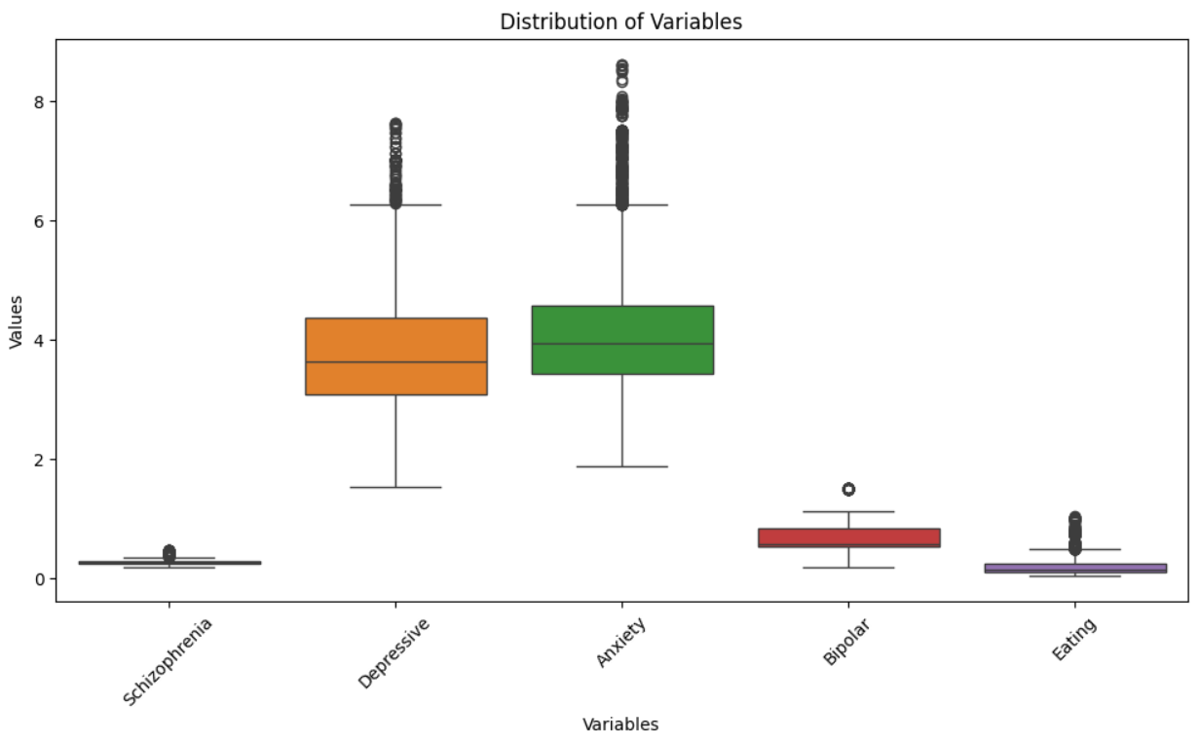
Outlier Detection
Prior to analysis, the data underwent preprocessing to ensure consistency and reliability. This involved cleaning the data to remove inconsistencies, missing values, and outliers that could affect the analysis. Transformations were applied to achieve stationarity where necessary for time series analysis.
1
Data Cleaning
Remove inconsistencies and missing values
2
Outlier Detection
Identify and handle outliers in the dataset
3
Transformation
Apply transformations for stationarity

Slide 10
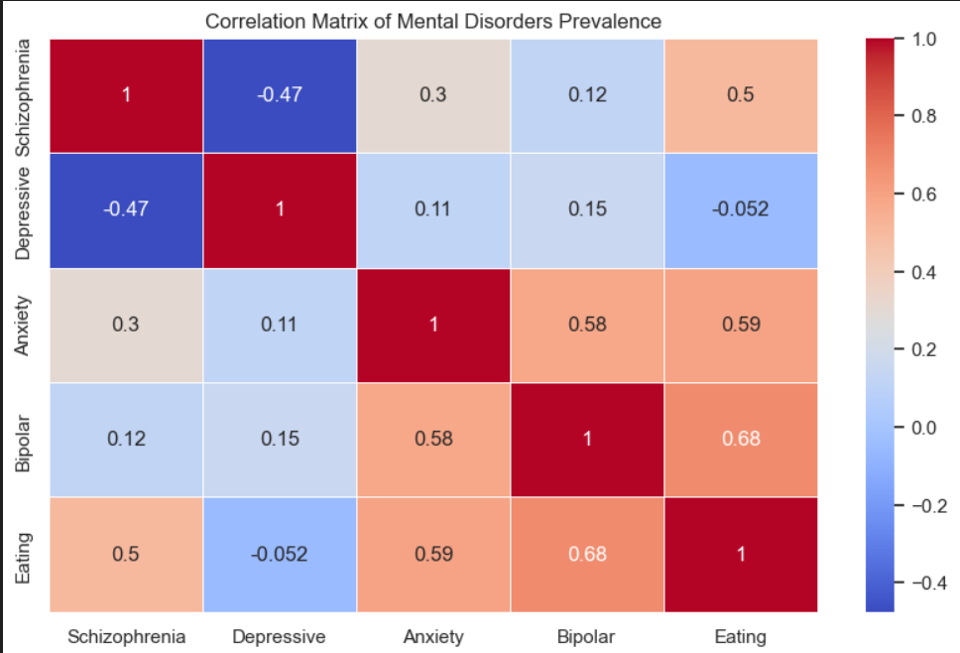



Correlation Analysis
The geographical maps highlighted regional differences in the prevalence of mental disorders, with some regions showing higher rates than others. This visualization provided valuable insights into the spatial distribution of mental health issues across different countries and regions.
Global View
Regional Patterns
Comparative Analysis
Worldwide distribution of mental health disorders
Identification of high-prevalence regions
Comparison of disorder rates across countries

Slide 11
Geographical Distribution
The geographical maps highlighted regional differences in the prevalence of mental disorders, with some regions showing higher rates than others. This visualization provided valuable insights into the spatial distribution of mental health issues across different countries and regions.
Global View
Regional Patterns
Comparative Analysis
Worldwide distribution of mental health disorders
Identification of high-prevalence regions
Comparison of disorder rates across countries

Slide 12
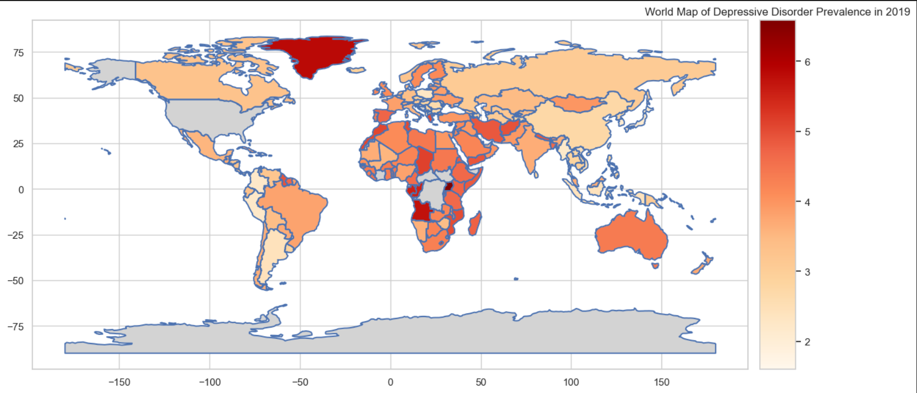
Geographical Distribution
The geographical maps highlighted regional differences in the prevalence of mental disorders, with some regions showing higher rates than others. This visualization provided valuable insights into the spatial distribution of mental health issues across different countries and regions.
Global View
Regional Patterns
Comparative Analysis
Worldwide distribution of mental health disorders
Identification of high-prevalence regions
Comparison of disorder rates across countries

Slide 13




Time Series Analysis
A detailed time series analysis was conducted to examine the temporal trends of mental health disorders in Pakistan. Notable observations include a consistent upward trend in depressive disorders, stable patterns in schizophrenia prevalence, and varying trends in anxiety disorders over time. These findings provide insights into the evolving landscape of mental health disorders in Pakistan.
Data Collection
Gather time series data for Pakistan
Trend Analysis
Identify patterns and trends over time
Interpretation
Draw insights from observed trends

Slide 14
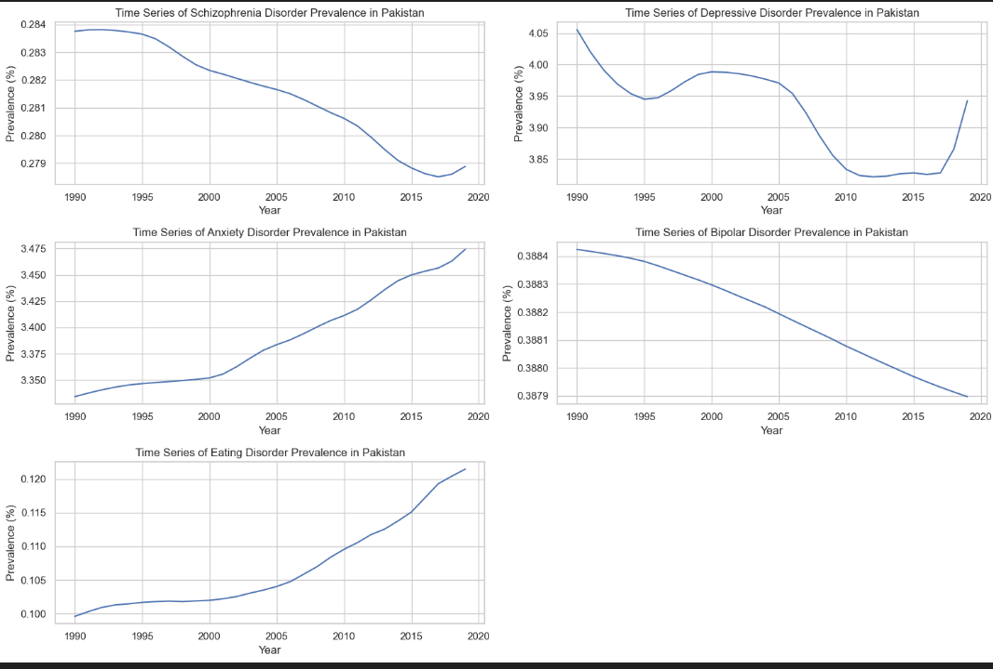
Trend Analysis

Slide 15
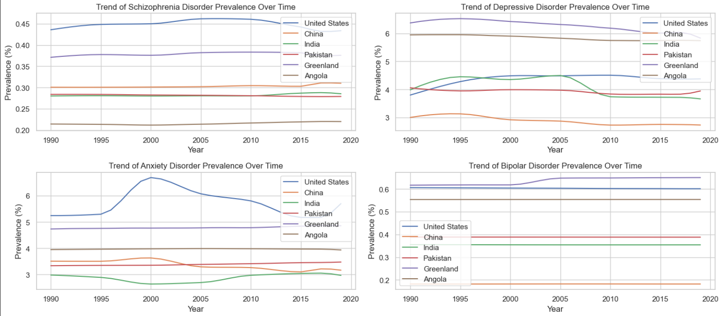
Trends for different Countries

Slide 16
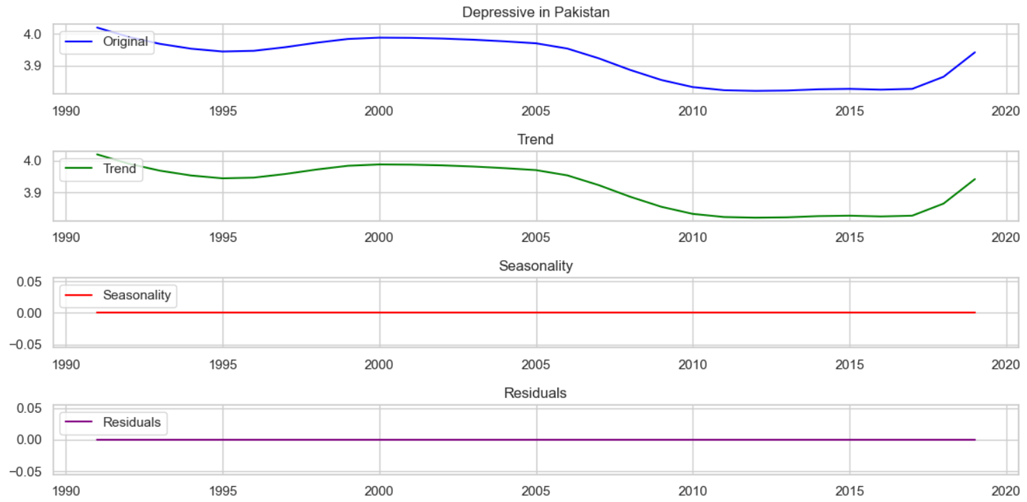
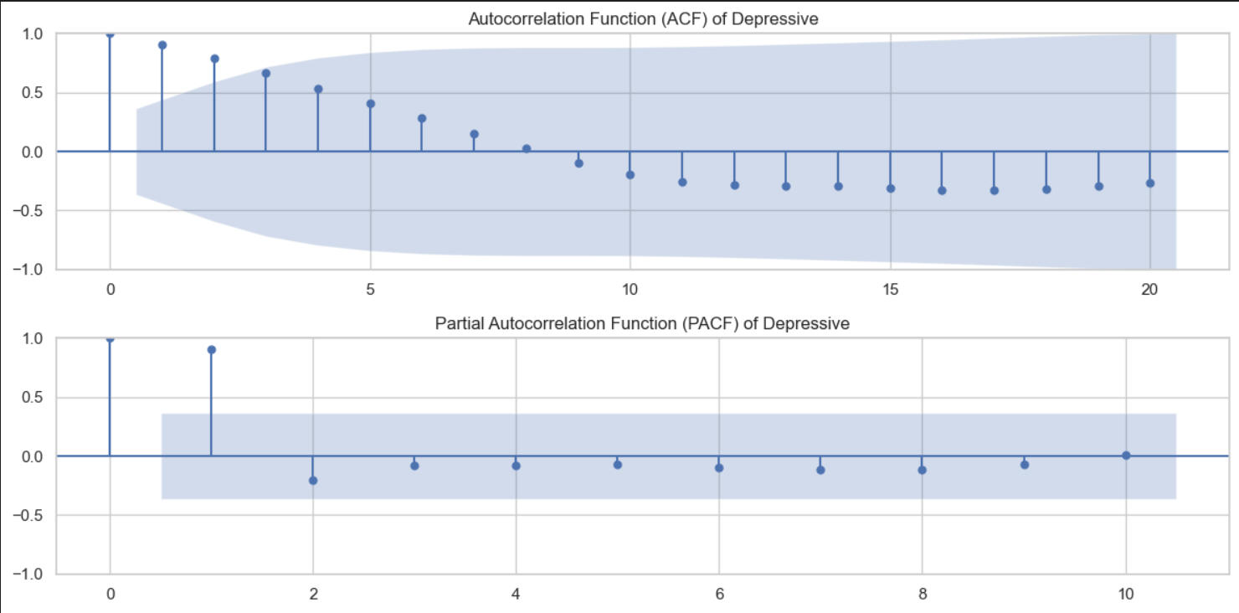
Trend, Seasonality and Residuals

Slide 17

ARIMA Modeling and Forecasting
ARIMA (AutoRegressive Integrated Moving Average) models were employed to forecast the prevalence of depressive and anxiety disorders in Pakistan. The differenced data was utilized for modeling, and ARIMA parameters were selected based on ACF/PACF analysis and model evaluation criteria. Future values were forecasted for the next ten years, providing valuable insights into potential trends and patterns.
1
Model Selection
2
Model Fitting
3
Forecasting
Choose appropriate ARIMA parameters based on analysis
Fit ARIMA models to the differenced data
Generate 10-year forecasts for depressive and anxiety disorders

Slide 18
Stationarity Testing and Autocorrelation Analysis
Augmented Dickey-Fuller tests were conducted to assess the stationarity of the data. Differencing was applied to non-stationary series to achieve stationarity. Autocorrelation Function (ACF) and Partial Autocorrelation Function (PACF) plots were generated for each mental health disorder, providing insights into the correlation between observations at different time lags. This analysis aided in the selection of appropriate parameters for ARIMA modeling.
Test
Purpose
Augmented Dickey-Fuller
Assess stationarity
ACF
Analyze autocorrelation
PACF
Analyze partial autocorrelation

Slide 19
ACF and PACF of Depressive Disorder

Slide 20
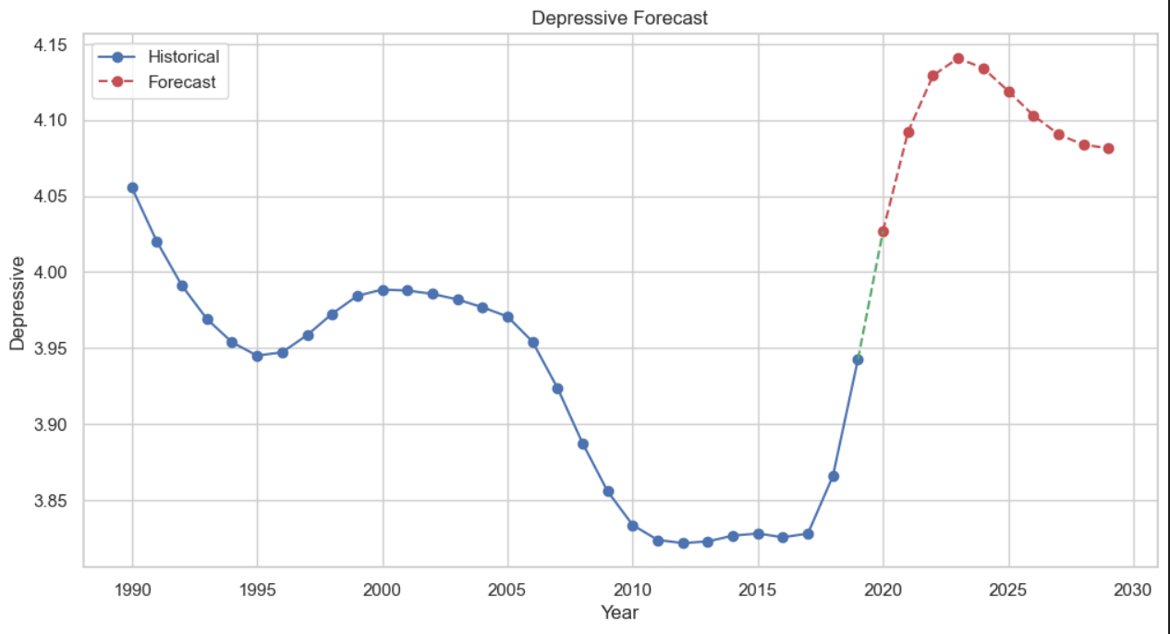
Depressive Disorder Forecasting for next 10 years

Slide 21
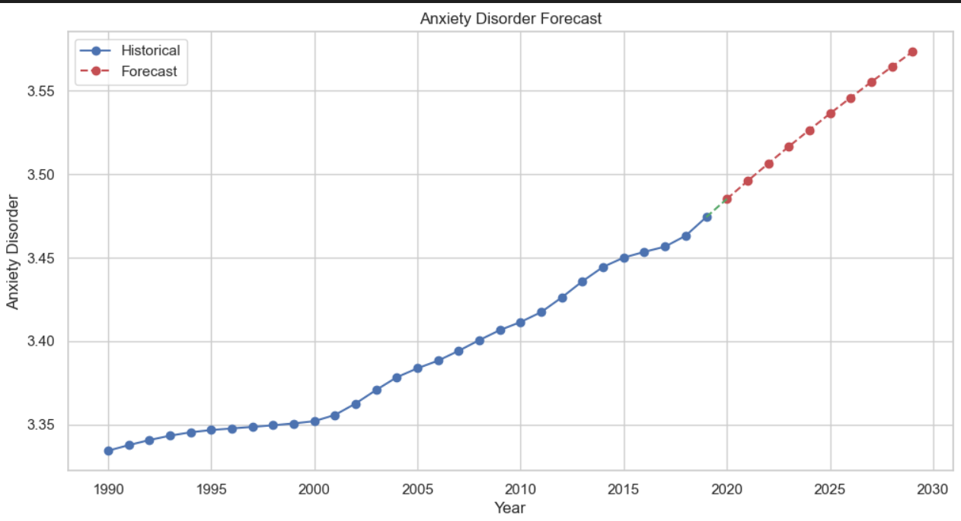
Anxiety Disorder Forecasting for next 10 years

Slide 22
Clustering Analysis
Multiple clustering methods were applied to the dataset: K-means, Hierarchical Clustering, DBSCAN, Principal Component Analysis (PCA). Each method offered unique insights into grouping countries based on mental health metrics. K-means partitioned the data into clusters with the nearest mean, while DBSCAN identified clusters based on density. PCA reduced dimensionality for better visualization, provided a way to visualize high-dimensional data.
K-means
Hierarchical
Partition data into k clusters
Create a tree of clusters
DBSCAN
PCA
Density-based clustering
Dimensionality reduction and visualization

Slide 23
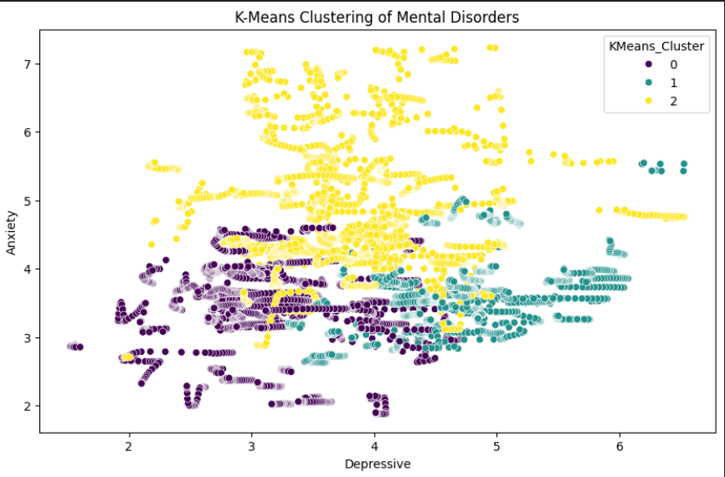
K-Means Clustering
Multiple clustering methods were applied to the dataset: K-means, Hierarchical Clustering, DBSCAN, Principal Component Analysis (PCA), and Self-Organizing Maps (SOM). Each method offered unique insights into grouping countries based on mental health metrics. K-means partitioned the data into clusters with the nearest mean, while DBSCAN identified clusters based on density. PCA reduced dimensionality for better visualization, and SOM provided a way to visualize high-dimensional data.
K-means
Hierarchical
Partition data into k clusters
Create a tree of clusters
DBSCAN
PCA & SOM
Density-based clustering
Dimensionality reduction and visualization

Slide 24
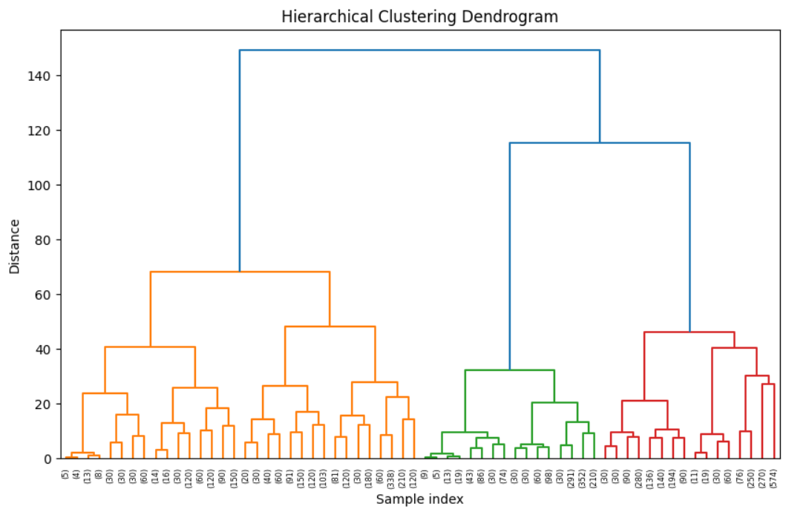
Hierarchical Clustering
Multiple clustering methods were applied to the dataset: K-means, Hierarchical Clustering, DBSCAN, Principal Component Analysis (PCA), and Self-Organizing Maps (SOM). Each method offered unique insights into grouping countries based on mental health metrics. K-means partitioned the data into clusters with the nearest mean, while DBSCAN identified clusters based on density. PCA reduced dimensionality for better visualization, and SOM provided a way to visualize high-dimensional data.
K-means
Hierarchical
Partition data into k clusters
Create a tree of clusters
DBSCAN
PCA & SOM
Density-based clustering
Dimensionality reduction and visualization

Slide 25
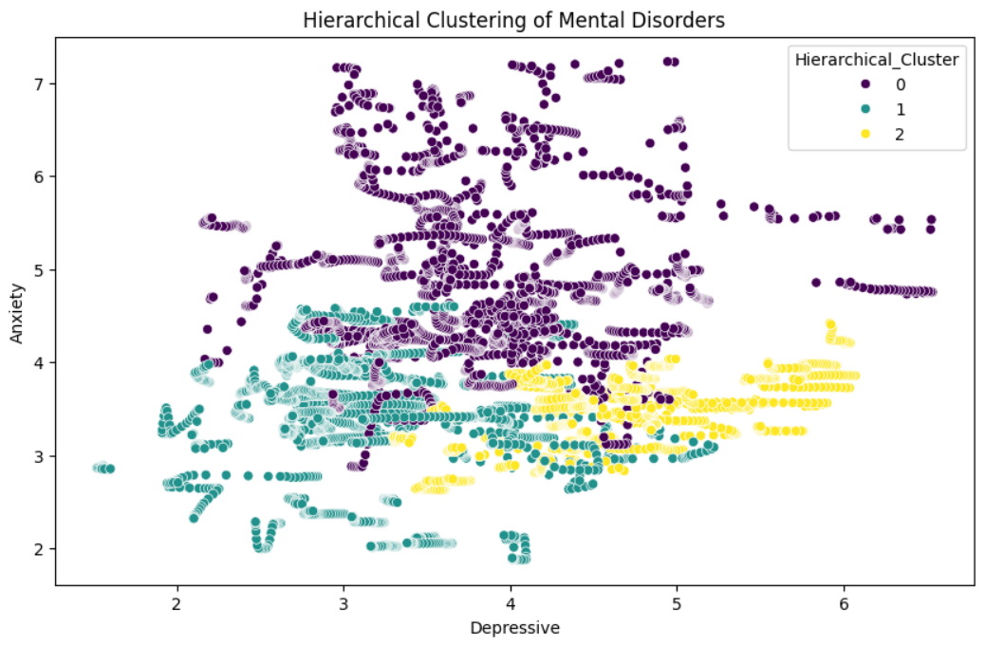
Hierarchical Clustering
Multiple clustering methods were applied to the dataset: K-means, Hierarchical Clustering, DBSCAN, Principal Component Analysis (PCA), and Self-Organizing Maps (SOM). Each method offered unique insights into grouping countries based on mental health metrics. K-means partitioned the data into clusters with the nearest mean, while DBSCAN identified clusters based on density. PCA reduced dimensionality for better visualization, and SOM provided a way to visualize high-dimensional data.
K-means
Hierarchical
Partition data into k clusters
Create a tree of clusters
DBSCAN
PCA & SOM
Density-based clustering
Dimensionality reduction and visualization

Slide 26
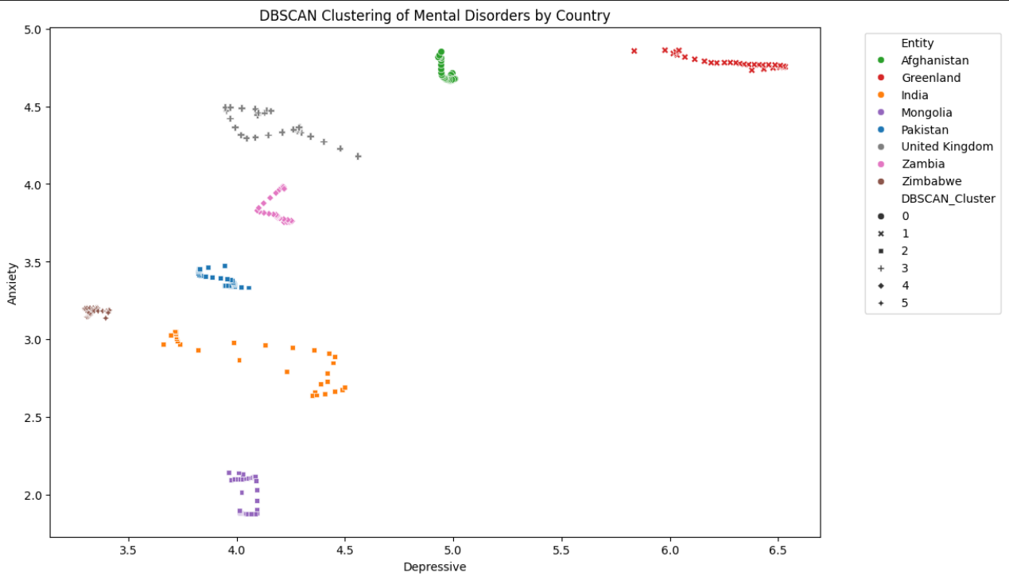
Clustering Analysis using DBSCAN
Multiple clustering methods were applied to the dataset: K-means, Hierarchical Clustering, DBSCAN, Principal Component Analysis (PCA), and Self-Organizing Maps (SOM). Each method offered unique insights into grouping countries based on mental health metrics. K-means partitioned the data into clusters with the nearest mean, while DBSCAN identified clusters based on density. PCA reduced dimensionality for better visualization, and SOM provided a way to visualize high-dimensional data.
K-means
Hierarchical
Partition data into k clusters
Create a tree of clusters
DBSCAN
PCA & SOM
Density-based clustering
Dimensionality reduction and visualization

Slide 27
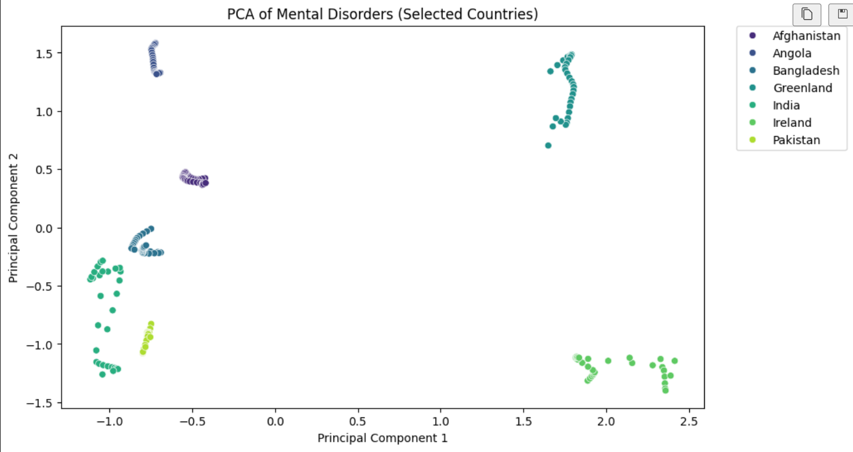
Clustering Analysis using PCA
Multiple clustering methods were applied to the dataset: K-means, Hierarchical Clustering, DBSCAN, Principal Component Analysis (PCA), and Self-Organizing Maps (SOM). Each method offered unique insights into grouping countries based on mental health metrics. K-means partitioned the data into clusters with the nearest mean, while DBSCAN identified clusters based on density. PCA reduced dimensionality for better visualization, and SOM provided a way to visualize high-dimensional data.
K-means
Hierarchical
Partition data into k clusters
Create a tree of clusters
DBSCAN
PCA & SOM
Density-based clustering
Dimensionality reduction and visualization

Slide 28

Conclusion and Implications
The comprehensive analysis of mental health disorder data provides valuable insights into the prevalence and trends of these disorders. Key findings include the escalating prevalence of depressive disorders and fluctuating patterns of anxiety disorders. The clustering analysis grouped countries based on mental health metrics, offering a clearer understanding of regional differences. These insights are essential for informing evidence-based interventions and policies aimed at improving mental health outcomes globally.
1
Data Analysis
Comprehensive exploration of mental health trends
2
Key Findings
Identification of significant patterns and correlations
3
Policy Implications
Informing interventions and mental health policies

